Slide 1

FAKE NEWS DETECTION
TEAM LEADER - K. Shiva Kalyan Kumar & P. Bindu Madhavi
DOCUMENTATION - P. Bindu Madhavi - 19BCE7124
DATA SCIENTIST - G. Bharath Sai - 19BCE7556
DATA ANALYST - K. Shiva Kalyan Kumar -19BCI7076

Slide 2

CONTENT:
Abstract
Introduction
Data Visualization
Data analysis
Conclusion
References

Slide 3
ABSTRACT:
Recent political events have lead to an increase in the popularity and spread of fake news.
As demonstrated by the widespread effects of the large onset of fake news, humans are inconsistent if not outright poor detectors of fake news.
With this, efforts have been made to automate the process of fake news detection. The most popular of such attempts include “blacklists” of sources and authors that are unreliable.

Slide 4
INTRODUCTION:
Fake news is something that everyone is very fond of and needs no introduction.
We have seen that internet use has taken off dramatically in recent years, as social media platforms such as Facebook, Twitter, WhatsApp, etc., have evolved.
We also should not forget to mention YouTube, one of the biggest culprits in spreading fake news among the population.
These applications have many benefits, such as sharing something useful for the betterment of the population. One biggest disadvantage is fake news, which spreads in the same way that fire spreads in a forest.
The reason for spreading fake news would be to achieve financial or political benefits for yourself or your organization.

Slide 5
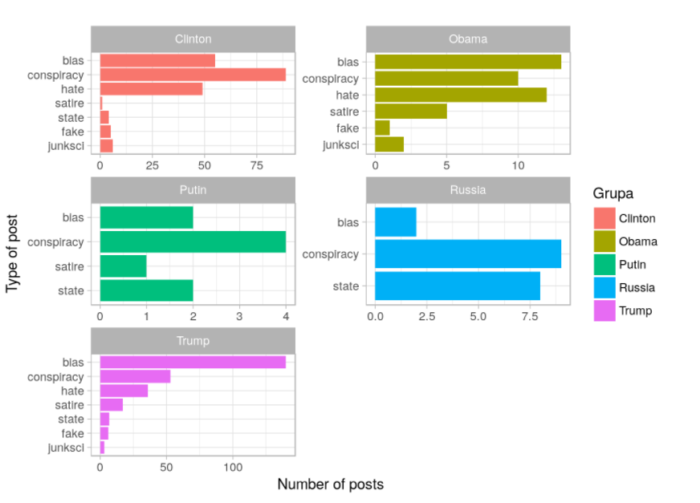
Main objects of interest [Donald Trump, Hillary Clinton, Barack Obama, Vladimir Putin, Russia].

Slide 6
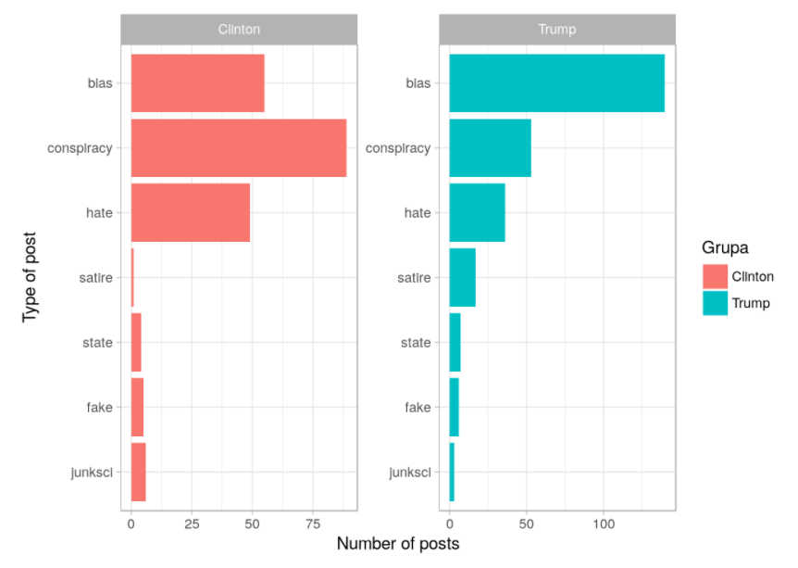
Extract main objects of interest.
Only Trump and Clinton have a satisfactory number of records to analyze. Therefore we decided to focus only on two groups of entry: the Trump and Clinton groups.

Slide 7
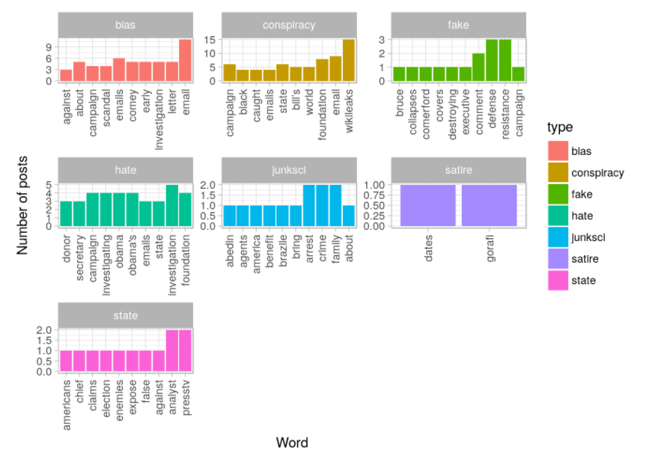
Most frequent words for Clinton and Trump group.

Slide 8
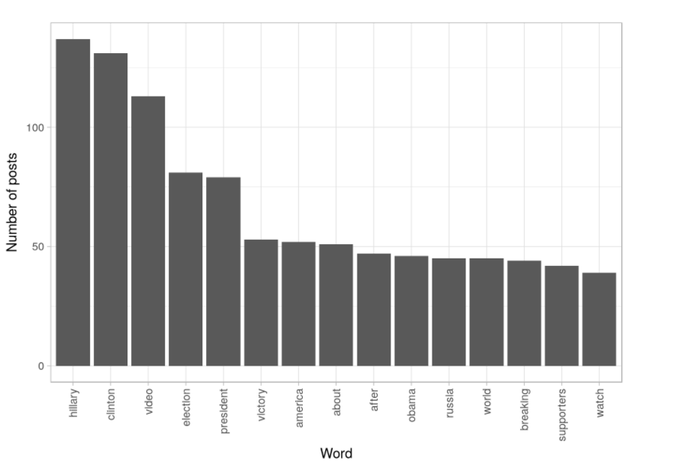
Most frequent words for Trump in bs type.

Slide 9
REFERENCES:
Fake news challenge stage 1 (fnc-i): Stance detection. [Online]. Available: http://www. fakenewschallenge.org/
J. Soll, T. Rosenstiel, A. D. Miller, R. Sokolsky, and J. Shafer. (2016, Dec) The long and brutal history of fake news. [Online]. Available: https://www.politico.com/magazine/story/2016/12/ fake-news-history-long-violent-214535 [3]
C. Wardle. (2017, May) Fake news. it’s complicated. [Online]. Available: https://firstdraftnews.com/ fake-news-complicated/ [4]
T. Ahmad, H. Akhtar, A. Chopra, and M. Waris Akhtar, “Satire detection from web documents using machine learning methods,” pp. 102–105, 09 2014.

Slide 10

THANK YOU

